Slide 1
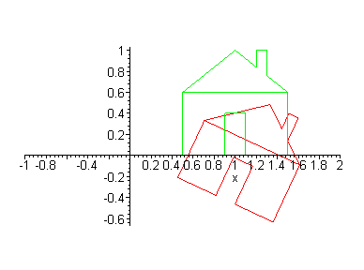
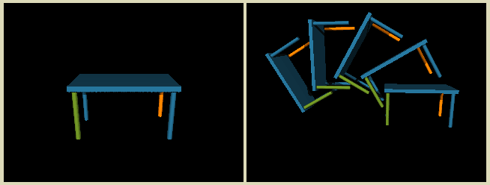
Computer Graphics
Helmuth Trefftz Gómez
Eafit

Slide 2
Agenda
2D Transforms
Translation
Rotation
Scaling
Composition
Homogeneous Coordinates

Slide 3
2D Transforms
In many applications it is necessary to modify the position, orientation or size of a 2D object.
The most widely used transformations are:
Translation: move one object to another position
Rotation: rotate the object around the origin
Scaling: change the size of the object

Slide 4
2D Transforms
We are going to see how to transform one point.
In order to transform an object, we transform the points that define it. For instance:
Polygon: its vertices
Circle: its center and, perhaps, its radius

Slide 5
2D TRANSFORMS – TRANSLATION
Add a distance in x and y to the point.
T
P’
P

Slide 6
Translation
Can be expressed as components or as addition of column vectors

Slide 7
Scaling
Changing the size of an object
In the figure, s_{x} = s_{y} = 0.5.
The size of the line is reduced and moved closer to the origin.

Slide 8
Scaling
Again as individual components or as operations with column vectors and matrices.

Slide 9
Rotation
A point is rotated around the origin.
Rotation is through an angle θ.
x’, y’
θ
x, y

Slide 10
Rotation
Again as components or as matrix multiplication.

Slide 11
Note on matrix operations
We can represent points as vector columns and pre-multiply by the matrices,
Or…
Represent points as row columns and post-multiply by the transposed matrices

Slide 12
Homogeneous Coordinates
We can represent scaling and rotations as matrix multiplications.
But translations are vector additions.
This makes composition of transforms harder.
Why?

Slide 13
Homogeneous Coordinates
So, how do we represent translations as matrix multiplications?

Slide 14
Homogeneous Coordinates
In H.C., a point (x,y) is represented as (x, y, W).
Two sets (x, y, W) and (x’, y’ W’) represent the same point in 2D iff a set is a multiple of the other.
In fact, all tuples (tx, ty, tW) where t!= 0 represent the same point and form a line in 3D.
When we normalize (divide by W) we get (x, y, 1).

Slide 15
Transforms in H.C.
Translation is represented as a matrix multiplication.
Or:

Slide 16
Scaling
Scaling matrix becomes:
Or,

Slide 17
Rotations
Rotation matrix becomes:
Or,

Slide 18
Rigid body transforms
Angles and lengths of lines are kept. For instance: combinations of rotations and translations.
If the 2x2 top left submatrix is orthogonal (row vectors are orthogonal and each vector has unit length). For instance: the rotation matrix.

Slide 19
Affine Transforms
Parallel lines keep parallel. Lengths and angles may changed.
For instant: start with a square, rotate 45 degrees and apply non-uniform scaling:

Slide 20
Composition of transformations
Example 1: Rotate an object around an arbitrary point.
Translate P so that the axis is at the origin
Rotate the object
Translate the object so that P returns to its position

Slide 21
Composition of Transformations
The final transform becomes a multiplication of several matrices.

Slide 22
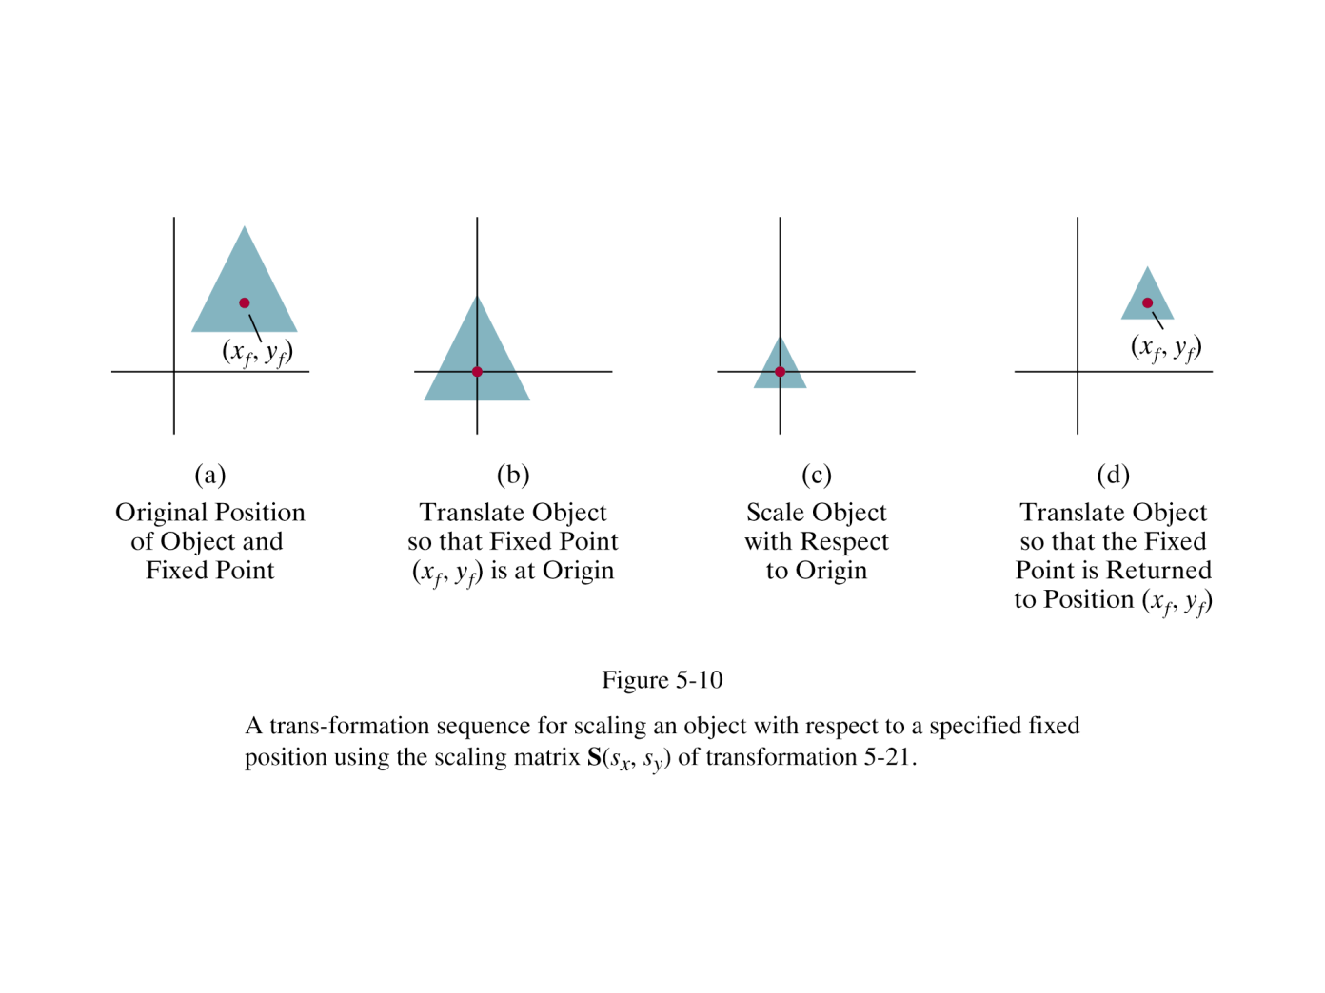
Composition of transformations
Example 2: Scaling an object in its place

Slide 23
Composition of transformations
Again, a multiplication of matrices

Slide 24
Inverse transformations
The inverse of transformation T is the inverse of its matrix representation (T⁻¹)
Eample: translation:

Slide 25
Inverse transformations
Rotation:
Remember that sin(-θ) = -sin(θ)
And cos(-θ) = cos(θ)
Note that R⁻¹ = R^{T} (wierd!)

Slide 26
Inverse transformations
Scaling:

Slide 27
Transformation composition properties
Multiplication of matrices is associative

Slide 28
Transformation Composition properties
Multiplication of matrices is, in general, not commutative:

Slide 29
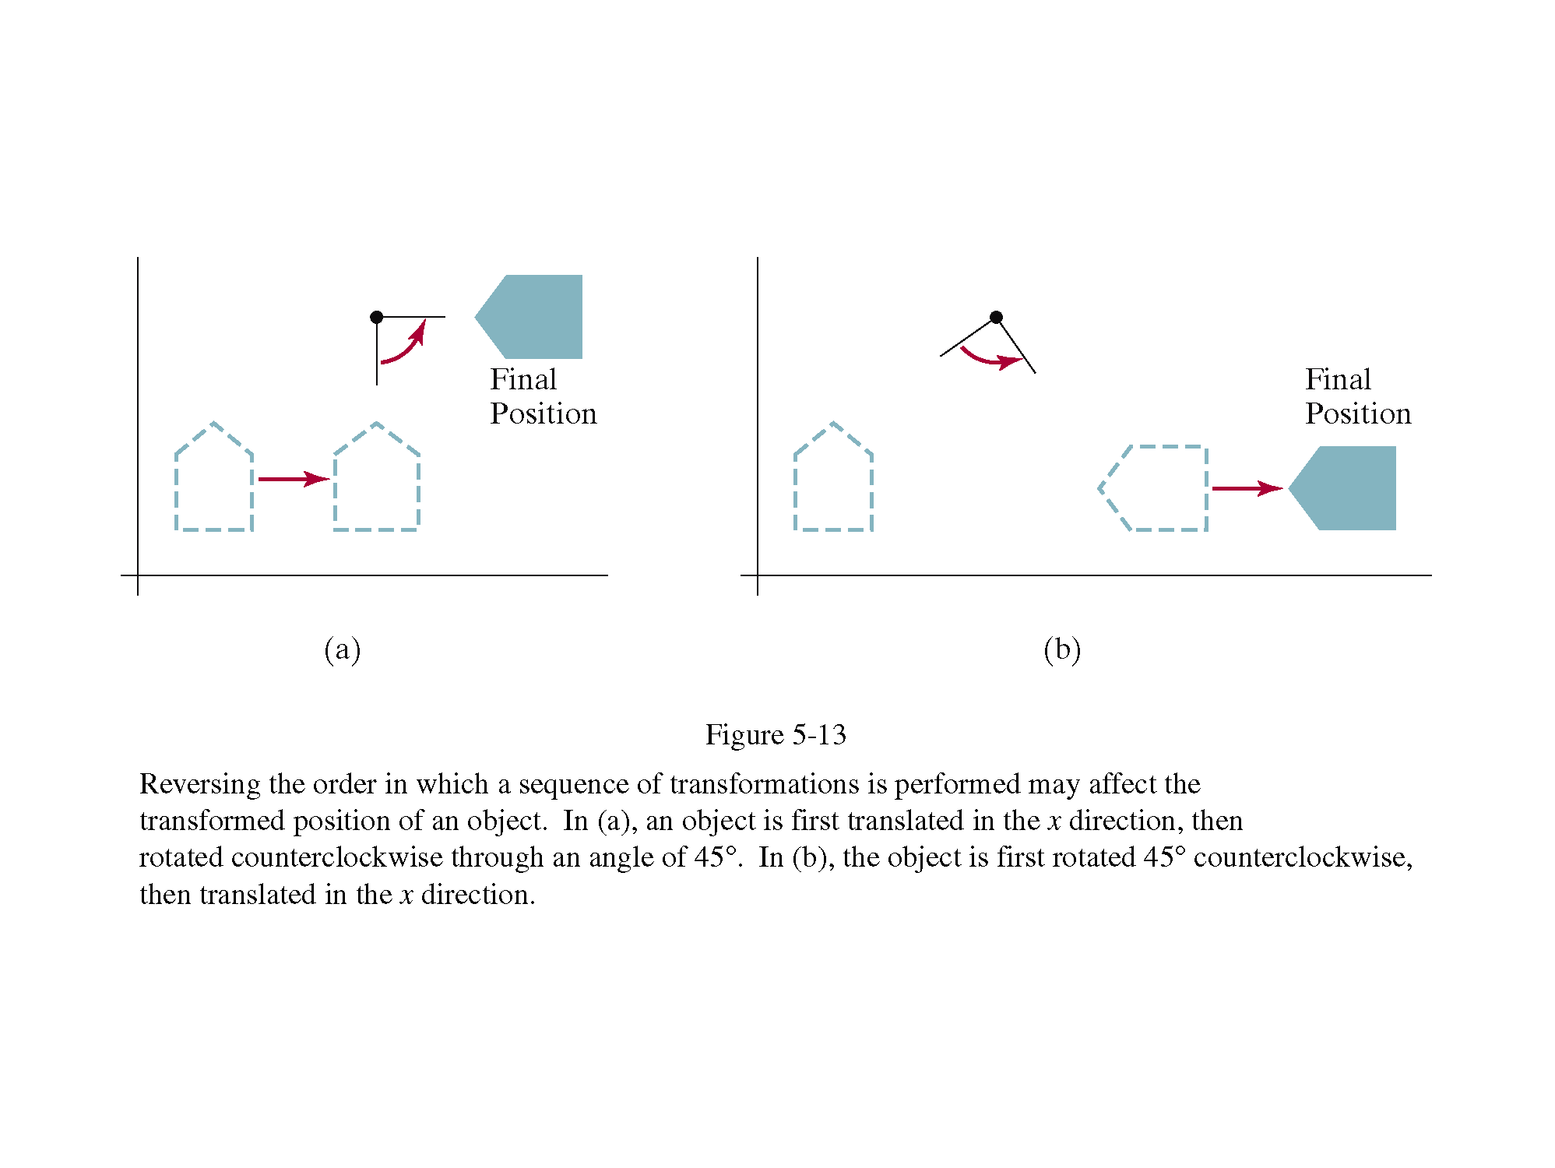
Transformation composition properties

Slide 30
Other two-dimensional transformations
What does this transformation matrix do?
Reflection around the x axis.

Slide 31
Other two-dimensional transformations
What about this one?

Slide 32
Other two-dimensional transformations
And this one?

Slide 33
Shear
A transformation that distorts the shape of an object such that the transformed shape appears as if the object were composed of internal layers that had been caused to slide over each other is called a shear.

Slide 34
Shear
The transformed positions are:

Slide 35
Credits
Images taken from Hearn & Baker. Computer Graphics with OpenGL. 3rd Ed.
First slide: from http://www.willamette.edu/~gorr/classes/GeneralGraphics/Transforms/transforms2d.htm
Reading: H&B 5.1, 5.2, pp 237 – 255.
A more formal description of Homegeneous Coordinates: http://deltaorange.com/2012/03/08/the-truth-behind-homogenous-coordinates/

